Slide 1
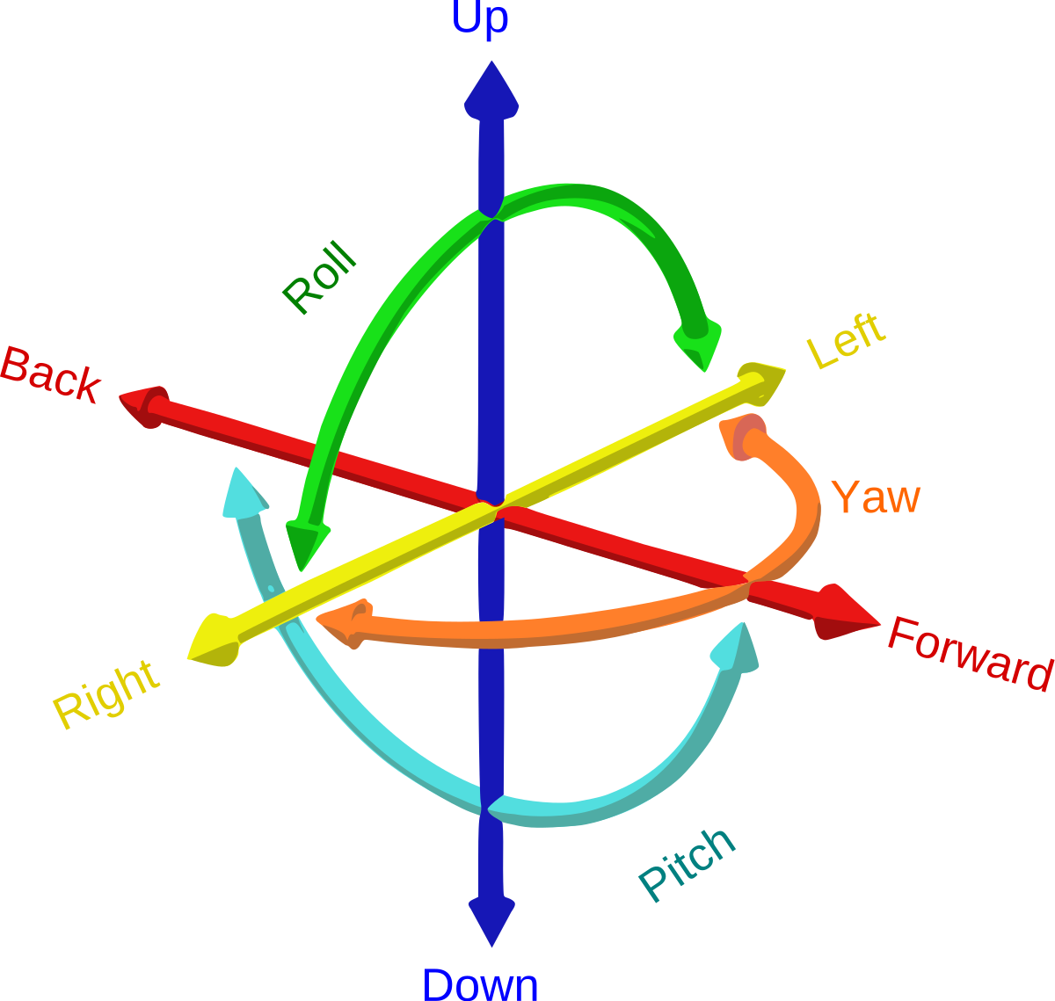
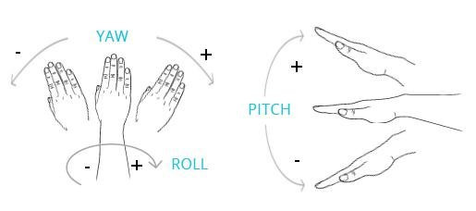
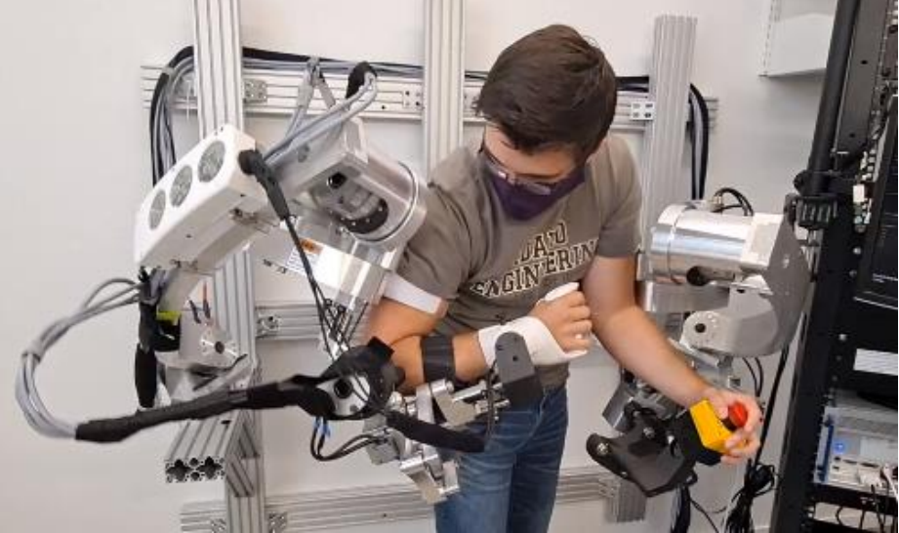
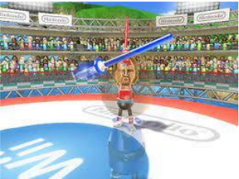
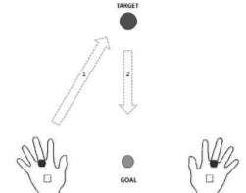
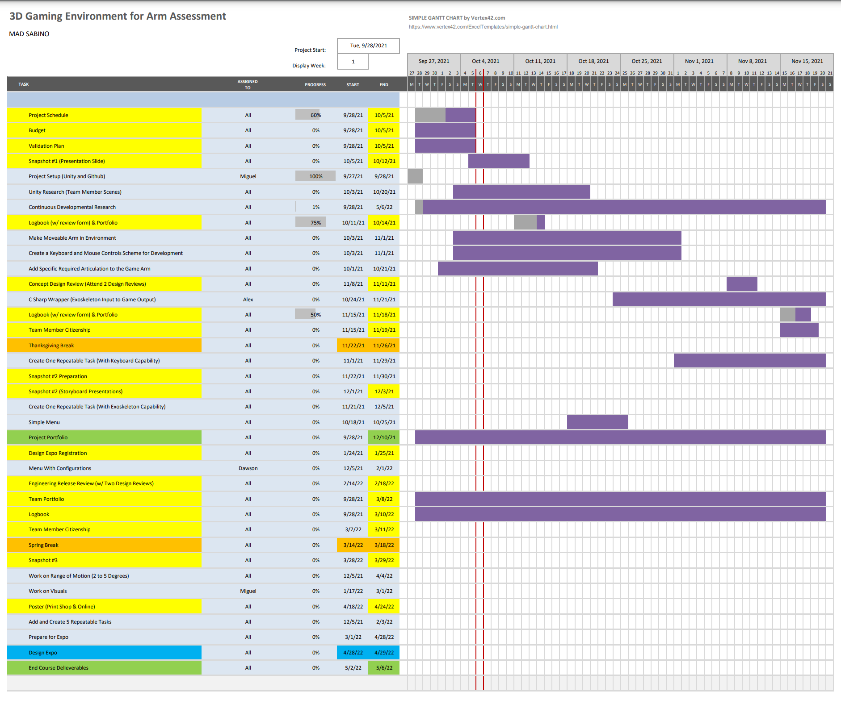
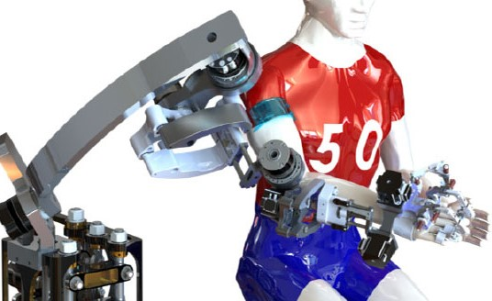
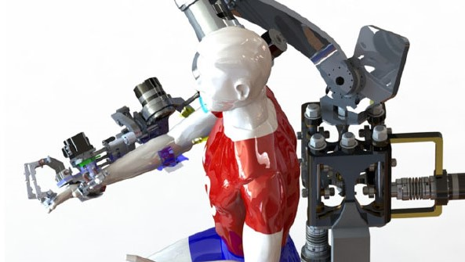
3D Gaming Environment for Arm Assessment
Team: MAD SABINO (Dawson Hill, Alex Pena, Miguel Villanueva)
Sponsor: UI ME
Problem:
The ME Department at the University of Idaho has built an exoskeleton called the BLUE SABINO which helps assess the arm and hand movements of individuals with neurological impairment, such as those who suffer from stroke. A better task environment is needed to support future clinical tests using this exoskeleton.
Solution:
Our approach is to create a better task environment using a 3D game engine.
BLUE SABINO:
BiLateral Upper-limb Exoskeleton for
Simultaneous Assessment of Biomechanics and Neuromuscular Output
Assessment:
Repeatable and consistent tasks.
Game Engine:
Unity
Schedule:
Where we want to go:
Unity Research
Completing one task (e.g., point to point reach)
Capturing exoskeleton outputs
Degrees of Freedom (start at 2, up to 5)
Budget:
$500

